Slide 1




Consumer goods analysis Ad_hoc Insights
Suman Kumari Raulo

Slide 2
About Atliq Hardware
Atliq Hardwares (Imaginary Company) Is A Leading Computer Hardware Producer In India And Is Expanding Globally.
INTRODUCTION
BACKGROUND
The Management Noticed That They Do Not Get Enough Insights To Make Quick And Smart Data-informed Decisions. The Management Recognizes The Importance Of Data Analytics In Driving Informed Business Decisions And Has Decided To Strengthen Their Data Analytics Team By Hiring Several Junior Data Analysts.

Slide 3
•Atliq Hardwares Is Seeking Insights On 10 Ad Hoc Requests For Their Business Purpose. A SQL Query-based Solution Is Required To Answer The Requests. Creativity In Presenting Insights. The Insights Should Satisfy Target Audience Top-level Management.
REQUIREMENTS
DATASET
The Dataset contains 6 Main tables
1. Dim_customer: Contains Customer-related Data.
2. Dim_product: Contains Product-related Data.
3. Fact_gross_price: Contains Gross Price Information For Each Product.
4. Fact_manufacturing_cost: Contains The Cost Incurred In The Production Of Each Product.
5. Fact_pre_invoice_deductions: Contains Pre-invoice
Deductions Information For Each Product.
6. Fact_sales_monthly: Contains Monthly Sales Data For
Each Product.

Slide 4
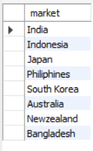
Request 1 . Provide The List Of Markets In Which Customer "Atliq Exclusive" Operates Its Business In The APAC Region.
Atliq Exclusive Operates Its Business In The APAC Region
OUTPUT :

Slide 5
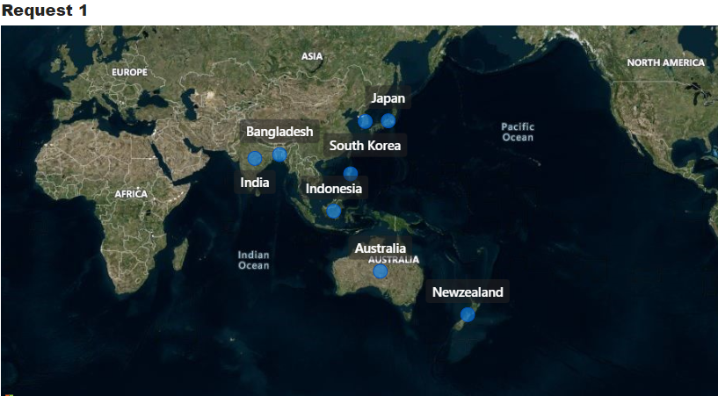
Conversion of Output to visual
Insights
Atliq Exclusive Operates Its Business In The APAC Region In Only 8 Markets Like India, Indonesia , Japan , Philippines , South Korea ,Australia , New Zealand , Bangladesh

Slide 6

Percentage Of Unique Product Increase In 2021 Vs. 2020
Request 2. What Is The Percentage Of Unique Product Increase In 2021 Vs. 2020? The Final Output Contains These Fields,
Unique_products_2020
Unique_products_2021
Percentage_chg
OUTPUT :

Slide 7
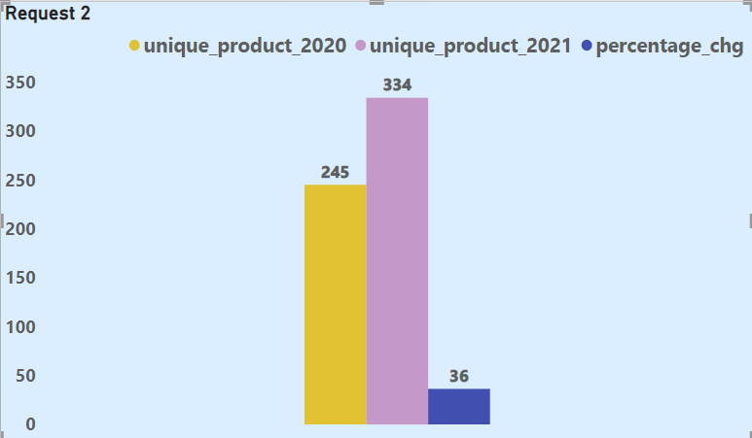
Conversion of Output to visual
Insights
Atliq Hardware Had 245 Unique Product In Year 2020 Whereas 334 Unique Product In 2021 It Means The Atliq Hardware Products Has Increased By 36.33% .

Slide 8
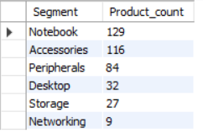
Request 3. Provide A Report With All The Unique Product Counts For Each Segment And Sort Them In Descending Order Of Product Counts. The Final Output Contains 2 Fields, Segment Product_count
Unique Product Count For Segments
OUTPUT :

Slide 9
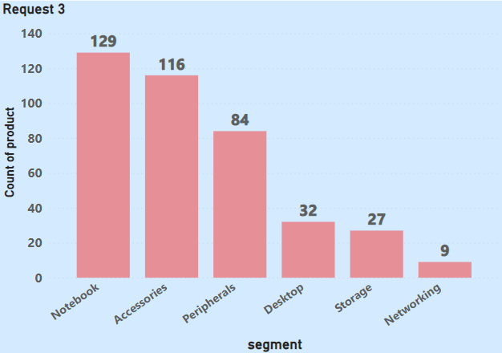
Conversion of Output to visual
Insights
Based On Output It Has 6 Segments That Contains Notebook , Accessories , Peripherals , Desktop , Storage And Networking.
The Notebook Segment Contain The Highest Number Of Count Of Product Is 129 And Network Segment Contains The Lowest Count Of Product Is 9. .

Slide 10
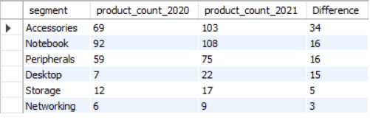
Request 4. Follow-up: Which Segment Had The Most Increase In Unique Products In 2021 Vs 2020? The Final Output Contains These Fields, Segment Product_count_2020 Product_count_2021 Difference
Segment Wise Most Increase In Unique Products In 2020 Vs 2020
OUTPUT :

Slide 11
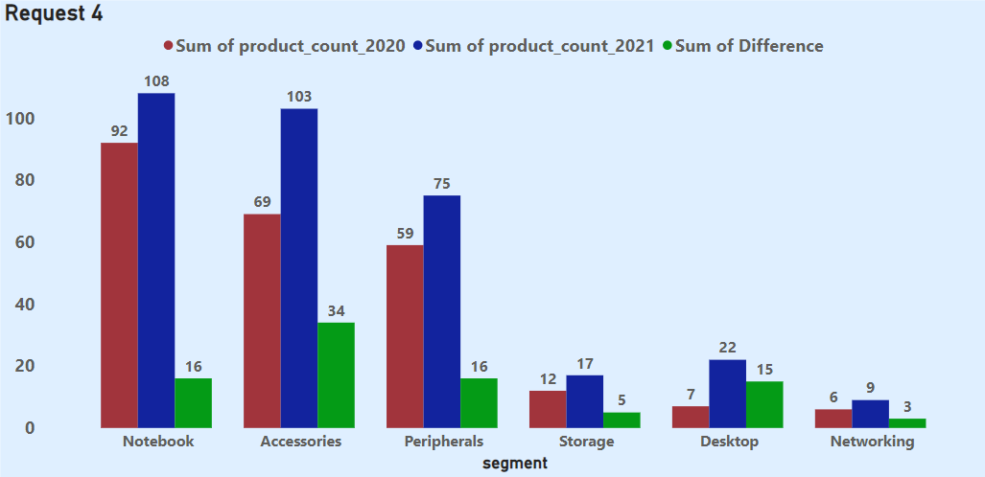
Conversion of Output to visual
Insights
In This Visual We Can See That All The Segment Of 2021 Has Been Increased Compared To Year 2020.
Accessories Segment Increased By 34 New Products In Year 2020 To 2021 .
In Notebook And Peripheral Segments Increased By 16 Product.

Slide 12

Request 5. Get The Products That Have The Highest And Lowest Manufacturing Costs. The Final Output Should Contain These Fields, Product_code Product Manufacturing_cost
Products That Have The Highest And Lowest Manufacturing Cost
OUTPUT:

Slide 13
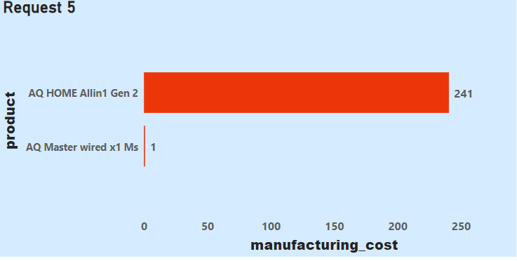
Conversion of Output to visual
Insights
AQ HOME Allin1 Gen 2 Is The Highest Manufacturing Cost Of 240.54.
AQ Master Wired X1 Ms Is The Lowest Manufacturing Cost Of 0.892.

Slide 14
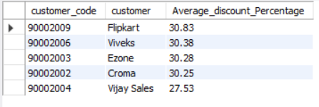
Request 6. Generate A Report Which Contains The Top 5 Customers Who Received An Average High Pre_invoice_discount_pct For The Fiscal Year 2021 And In The Indian Market. The Final Output Contains These Fields, Customer_code Customer Average_discount_percentage
Top 5 Customers Received An Average High Pre_invoice _Discount_pct For Fiscal Year 2021 In Indian Market
OUTPUT:

Slide 15
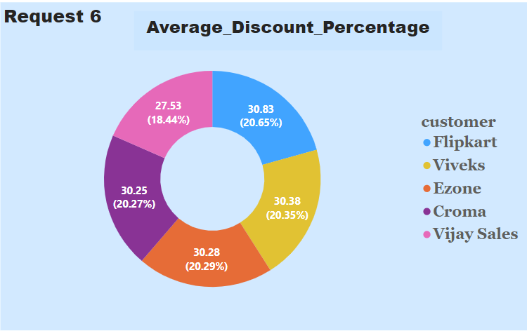
Conversion of Output to visual
Insights
In This Output In India Received Average High Pre_invoice_discount_percentage In Year 2021 And The Top 5 Customer Are Flipkart , Viveks , Ezone , Croma , Vijay Sales.
The Fiscal Year 2021 In India Average High Pre_invoice_discount_percentage Received Customer Is Flipkart (90002009)by 20.65%.

Slide 16
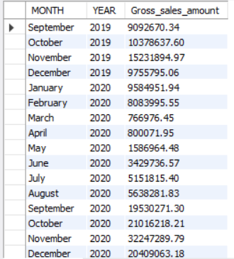
Request 7. Get The Complete Report Of The Gross Sales Amount For The Customer “Atliq Exclusive” For Each Month. This Analysis Helps To Get An Idea Of Low And High-performing Months And Take Strategic Decisions. The Final Report Contains These Columns: Month Year Gross Sales Amount
The Gross Sales Amount For The Customer “Atliq Exclusive” For Each Month
OUTPUT:

Slide 17
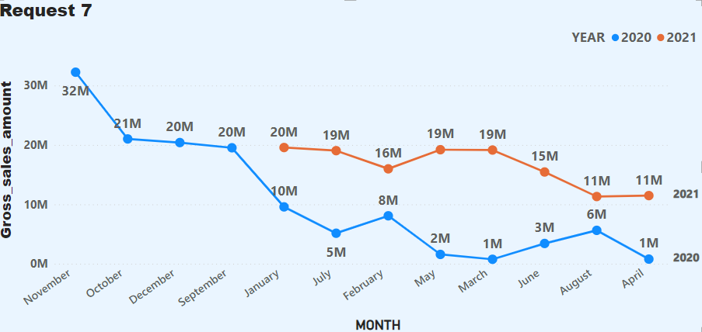
Conversion of Output to visual
Insights
The Gross Sales Amount For The Customer Atliq Exclusive For Each Month As It Has Shown The Highest Gross Sales In November 2020 Which Is 32 Millions.
The Lowest Gross Sales Of 0.77 Millions In March 2020.

Slide 18
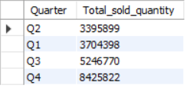
Request 8. In Which Quarter Of 2020, Got The Maximum Total_sold_quantity? The Final Output Contains These Fields Sorted By The Total_sold_quantity, Quarter Total_sold_quantity
Quarter Of 2020 Got The Maximum Total_sold_quantity
OUTPUT:

Slide 19
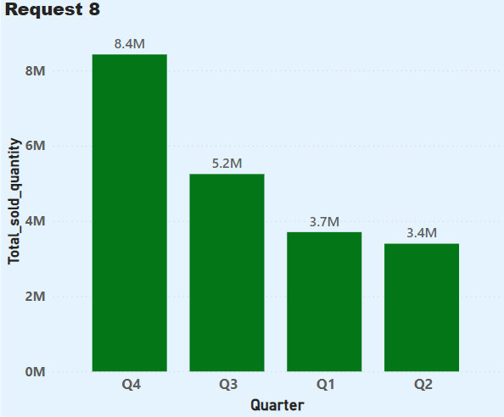
Conversion of Output to visual
Insights
The Maximum Of Total_sold_quantity Of Gross Sales Is Quarter Q4 8.4 Millions
The Minimum Of Total_sold_quantity Of Gross Sales Is Quarter Q2 3.4 Millions

Slide 20
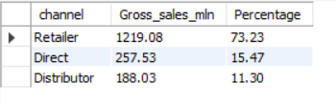
Request 9. Which Channel Helped To Bring More Gross Sales In The Fiscal Year 2021 And The Percentage Of Contribution? The Final Output Contains These Fields, Channel Gross_sales_mln Percentage
Channel Helped To Bring more Gross Sales In The Fiscal Year 2021 And The Percentage Of Contribution
OUTPUT:

Slide 21
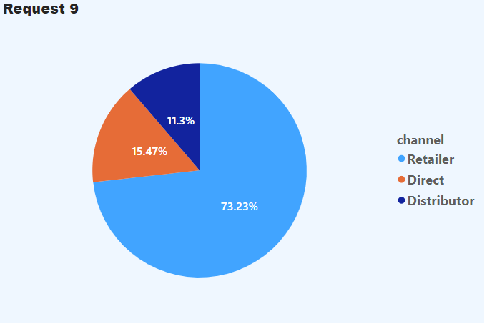
Conversion of Output to visual
Insights
Retailer Channel Helped To Bring More Gross Sales In The Fiscal Year 2021 And The Percentage Of Contribution Is 73.23%.
Distributor Channel Has The Less Gross Sales In The Fiscal Year 2021 The Percentage Of Contribution Is 11.3%.

Slide 22
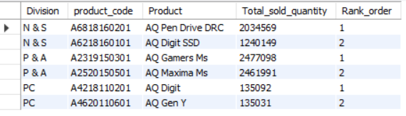
Request 10. Get The Top 3 Products In Each Division That Have A High Total_sold_quantity In The Fiscal_year 2021? The Final Output Contains These Fields, Division Product_code Product Total_sold_Quantity Rank_order
Top 3 Products In Each Division That Have A High Total_sold_quantity In The Fiscal Year 2021
OUTPUT:

Slide 23
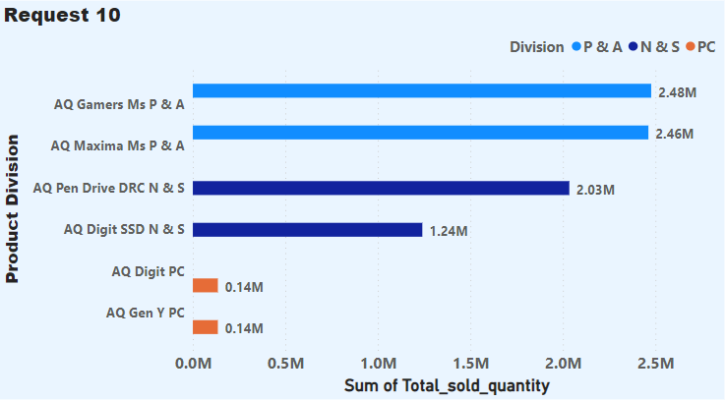
Conversion of Output to visual
Insights
In This Output There Are 3 Divisions They Are P&A , N&S And PC.
This Data Shows The Top 3 Product In Each Division That Has The Highest Selling In 2021.
The P & A Division Is The Most Sold Quantity Compared To N & S Division Products.

Slide 24


